Slide 1

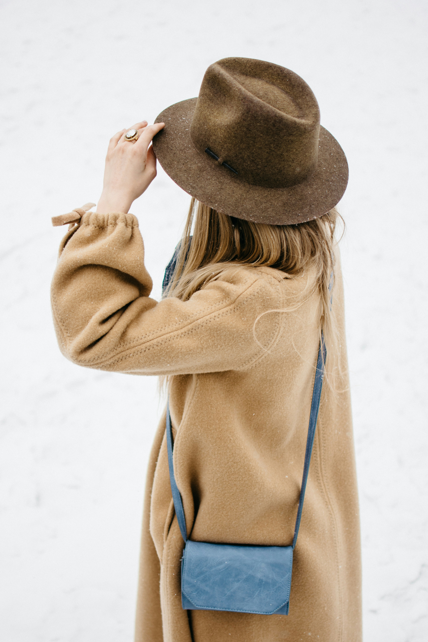
The Don'ts of Formal Dressing
The Do's of Formal Dressing
Conclusion
What is Formal Dressing?
Tailored suits and blazers are a must for men and women.
Choose classic colors like black, navy, or grey for a timeless look.
Invest in quality dress shoes and accessories to complete your ensemble.
For women, opt for modest hemlines and avoid overly revealing outfits.
Say no to casual wear like jeans, t-shirts, and sneakers.
Avoid loud, flashy patterns and opt for subtle, elegant designs.
Steer clear of excessive accessories that can overpower your outfit.
Refrain from wearing overly casual or revealing attire that may be inappropriate for formal settings.
Formal dressing is a way to project a polished, professional image. It's about dressing with intention and respect for the occasion. Formal attire varies based on the event, but it often includes tailored suits, crisp shirts, and elegant accessories.
Formal dressing is a powerful tool for making a lasting impression. By understanding the principles of formal attire and choosing your ensemble thoughtfully, you can exude confidence and professionalism in any formal setting. Remember, dressing formally is not just about the clothes; it's about the attitude and respect you bring to the occasion.
The Art of Formal Dressing
04
03
02
01

Slide 2
The Don'ts of Formal Dressing
The Do's of Formal Dressing
Conclusion
What is Formal Dressing?
Tailored suits and blazers are a must for men and women.
Choose classic colors like black, navy, or grey for a timeless look.
Invest in quality dress shoes and accessories to complete your ensemble.
For women, opt for modest hemlines and avoid overly revealing outfits.
Say no to casual wear like jeans, t-shirts, and sneakers.
Avoid loud, flashy patterns and opt for subtle, elegant designs.
Steer clear of excessive accessories that can overpower your outfit.
Refrain from wearing overly casual or revealing attire that may be inappropriate for formal settings.
Formal dressing is a way to project a polished, professional image. It's about dressing with intention and respect for the occasion. Formal attire varies based on the event, but it often includes tailored suits, crisp shirts, and elegant accessories.
Formal dressing is a powerful tool for making a lasting impression. By understanding the principles of formal attire and choosing your ensemble thoughtfully, you can exude confidence and professionalism in any formal setting. Remember, dressing formally is not just about the clothes; it's about the attitude and respect you bring to the occasion.
04
The Art of Formal Dressing
03
02
01

Slide 3
The Don'ts of Formal Dressing
The Do's of Formal Dressing
Conclusion
What is Formal Dressing?
Say no to casual wear like jeans, t-shirts, and sneakers.
Avoid loud, flashy patterns and opt for subtle, elegant designs.
Steer clear of excessive accessories that can overpower your outfit.
Refrain from wearing overly casual or revealing attire that may be inappropriate for formal settings.
Tailored suits and blazers are a must for men and women.
Choose classic colors like black, navy, or grey for a timeless look.
Invest in quality dress shoes and accessories to complete your ensemble.
For women, opt for modest hemlines and avoid overly revealing outfits.
Formal dressing is a powerful tool for making a lasting impression. By understanding the principles of formal attire and choosing your ensemble thoughtfully, you can exude confidence and professionalism in any formal setting. Remember, dressing formally is not just about the clothes; it's about the attitude and respect you bring to the occasion.
Formal dressing is a way to project a polished, professional image. It's about dressing with intention and respect for the occasion. Formal attire varies based on the event, but it often includes tailored suits, crisp shirts, and elegant accessories.
04
The Art of Formal Dressing
03
02
01

Slide 4
The Don'ts of Formal Dressing
Conclusion
The Do's of Formal Dressing
What is Formal Dressing?
Say no to casual wear like jeans, t-shirts, and sneakers.
Avoid loud, flashy patterns and opt for subtle, elegant designs.
Steer clear of excessive accessories that can overpower your outfit.
Refrain from wearing overly casual or revealing attire that may be inappropriate for formal settings.
Tailored suits and blazers are a must for men and women.
Choose classic colors like black, navy, or grey for a timeless look.
Invest in quality dress shoes and accessories to complete your ensemble.
For women, opt for modest hemlines and avoid overly revealing outfits.
Formal dressing is a powerful tool for making a lasting impression. By understanding the principles of formal attire and choosing your ensemble thoughtfully, you can exude confidence and professionalism in any formal setting. Remember, dressing formally is not just about the clothes; it's about the attitude and respect you bring to the occasion.
Formal dressing is a way to project a polished, professional image. It's about dressing with intention and respect for the occasion. Formal attire varies based on the event, but it often includes tailored suits, crisp shirts, and elegant accessories.
04
The Art of Formal Dressing
03
02
01

Slide 5
The Don'ts of Formal Dressing
The Do's of Formal Dressing
Conclusion
What is Formal Dressing?
Say no to casual wear like jeans, t-shirts, and sneakers.
Avoid loud, flashy patterns and opt for subtle, elegant designs.
Steer clear of excessive accessories that can overpower your outfit.
Refrain from wearing overly casual or revealing attire that may be inappropriate for formal settings.
Tailored suits and blazers are a must for men and women.
Choose classic colors like black, navy, or grey for a timeless look.
Invest in quality dress shoes and accessories to complete your ensemble.
For women, opt for modest hemlines and avoid overly revealing outfits.
Formal dressing is a powerful tool for making a lasting impression. By understanding the principles of formal attire and choosing your ensemble thoughtfully, you can exude confidence and professionalism in any formal setting. Remember, dressing formally is not just about the clothes; it's about the attitude and respect you bring to the occasion.
Formal dressing is a way to project a polished, professional image. It's about dressing with intention and respect for the occasion. Formal attire varies based on the event, but it often includes tailored suits, crisp shirts, and elegant accessories.
04
The Art of Formal Dressing
03
02
01

Slide 6
THANK YOU

